Slide 1

Hikerstop – Trekking Event Management system
C-DAC Advanced Computing Training School,ATC
NETCOM,Jaipur,Rajasthan
Project Guide:
Prajkta Mam
Created By:
Akash Bhosale
Sahil Pawar
Rushikesh Chavan
Amol Deore
Bhagwan Bhende

Slide 2
Table Of Content
Introduction
Need of project
Design and Implementation Constraints
Future Scope
5. Conclusion

Slide 3
Introduction
Trekking event management is the application of project management to create event such as trekking ,river rafting ,climbing, cycle riding etc.
It includes study of places identify audience and manage people before actually explore the places.
The process of planning and coordinating the event is usually refer to as event planning .
Which can include budgeting , scheduling event selection and acquiring necessary permits.
The admin is person who plans and execute the event taking responsibility for creative and technical elements.

Slide 4
Need Of Project
Many ‘Traveller ’ think that Direct go to Places and Explore them is easy, isn’t it? Unfortunately, like many things that seem simple creating a successful trip requires a lot of hard work and a diverse range of skills and experiences from project planning to budgets So We Come With Variety Of Places with User Friendly UI To Solve This Issue !

Slide 5
Benefits of Event Trekking Management System
Structural expansion of the visitor economy: Visitors coming to a city or
region for an event will contribute to a more buoyant economy, with visitor
expenditure having a multiplier effect on incomes throughout related supply
chains.
Environmental impacts: The international focus often associated with major events can help to prioritise work on an often under-developed or neglected built environment and therefore the attractiveness and competitiveness of Destinations
Marketing and promotion: Pre-event branding associated with the
successful hosting of a major event, can provide lasting recognition of
destination branding in key tourism markets, encourage return visitation of
attendees or participants, and a better understanding of the focus of the event
such as sport, arts and culture, food and wine, etc.

Slide 6
Modules In Project
Admin:
Admin can login to the system.
Add new Event.
View the list of Events.
Delete Events.
Update Events.
View information about Events
Manage customer
Customer:
Registration of Customer
Customer can login to the system.
View his/her details.
View Events.
Customer Can Manage Events.
Book Events
ViewEvents.

Slide 7
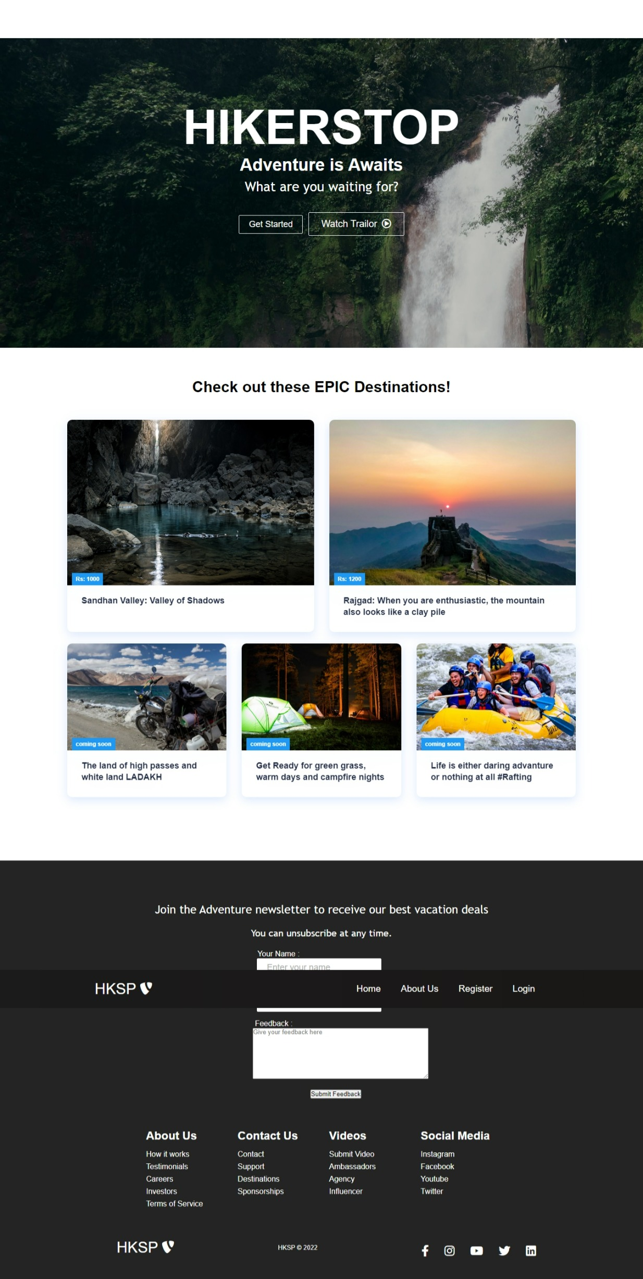

Slide 8
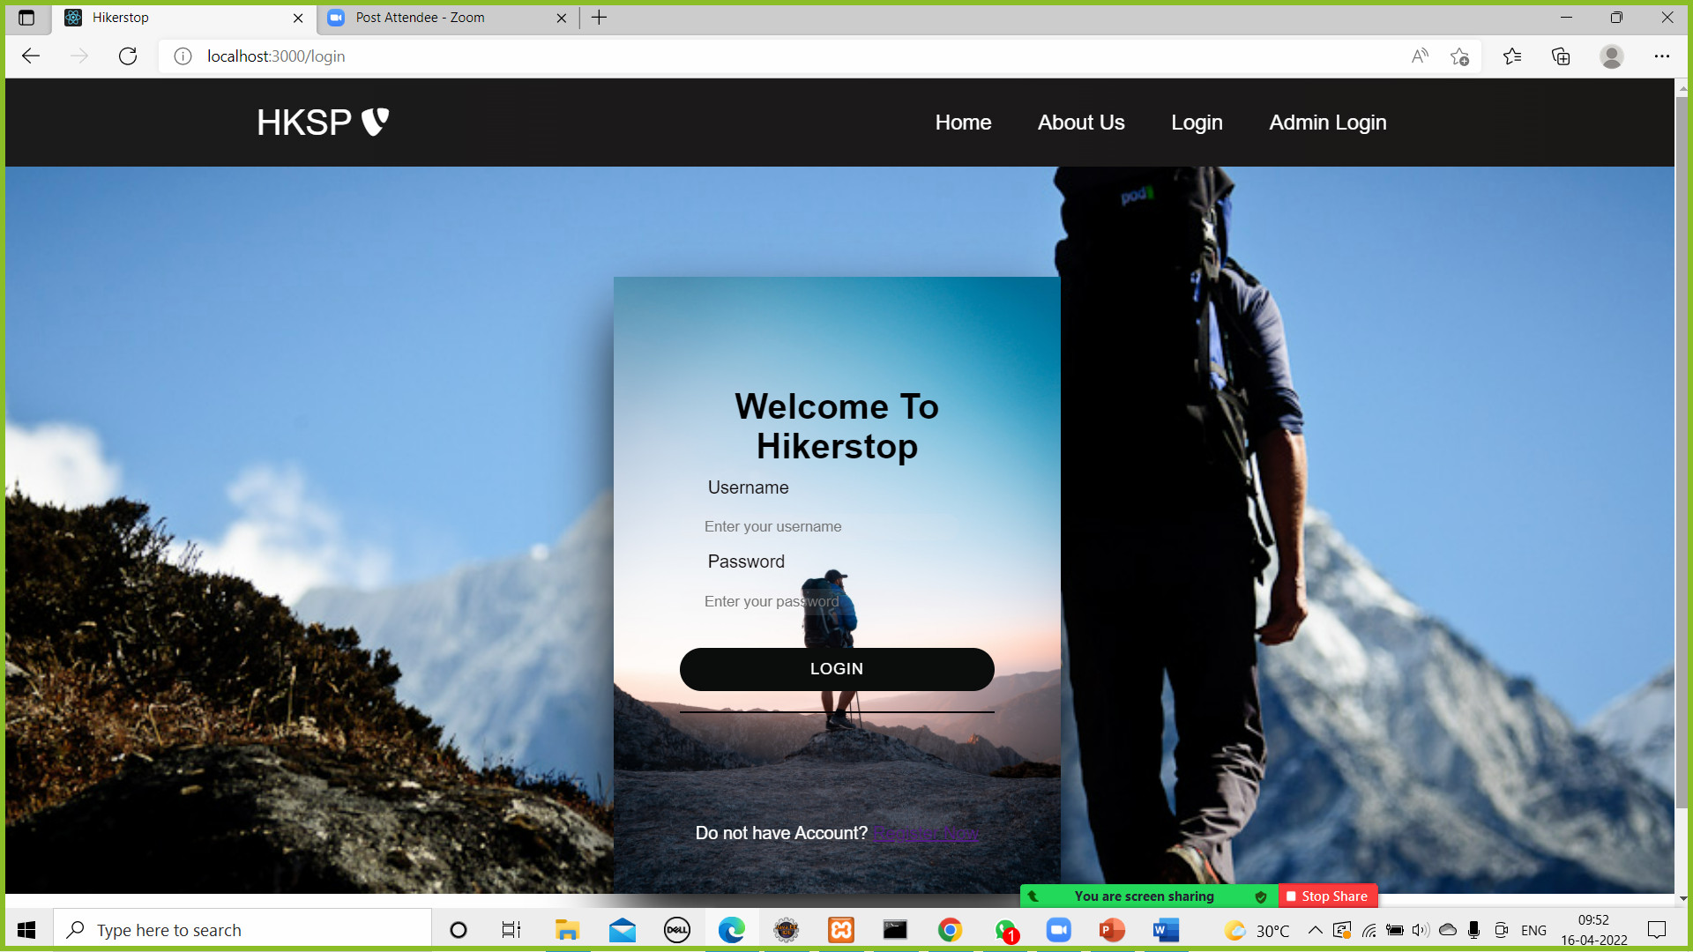

Slide 9
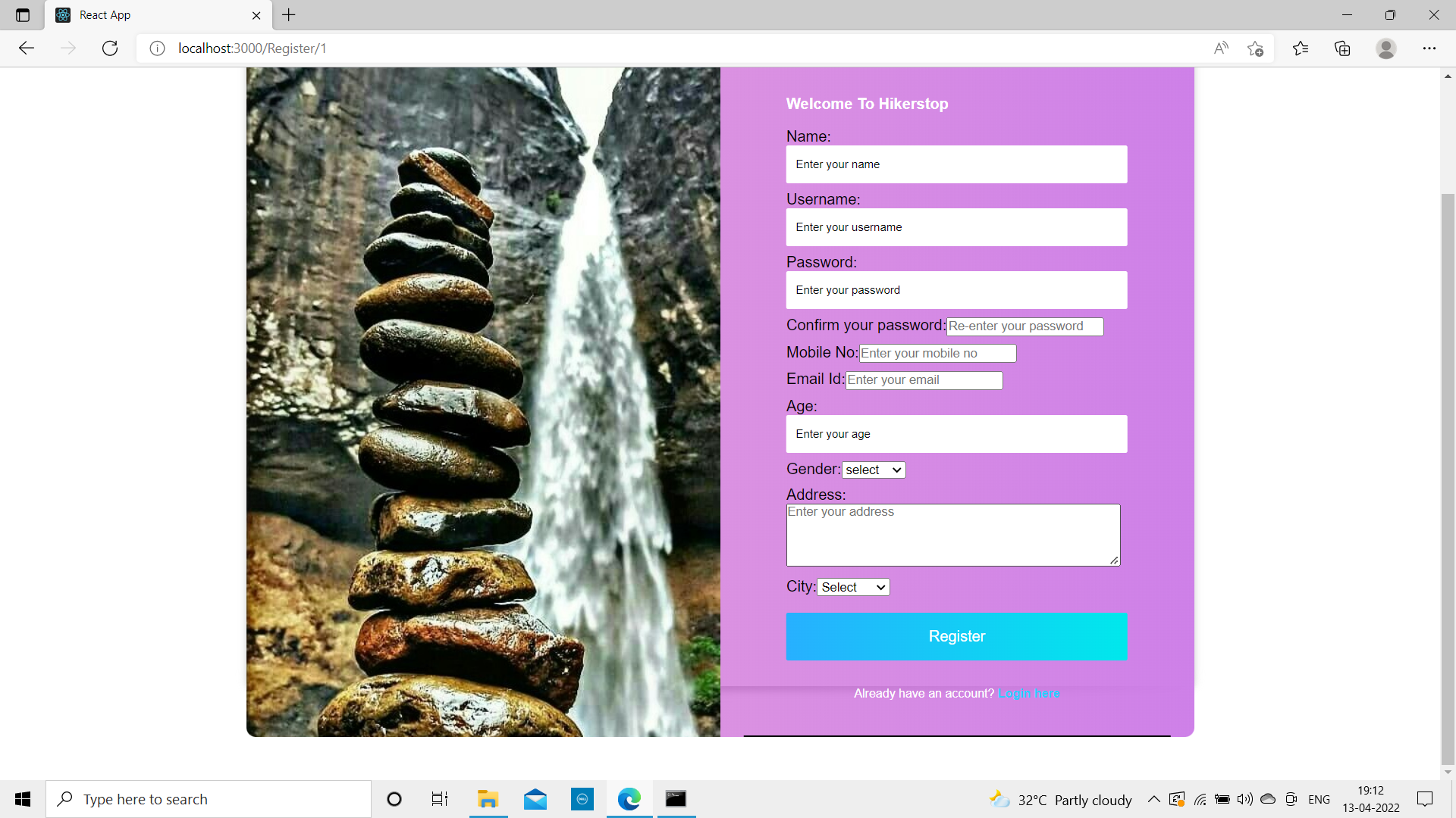

Slide 10
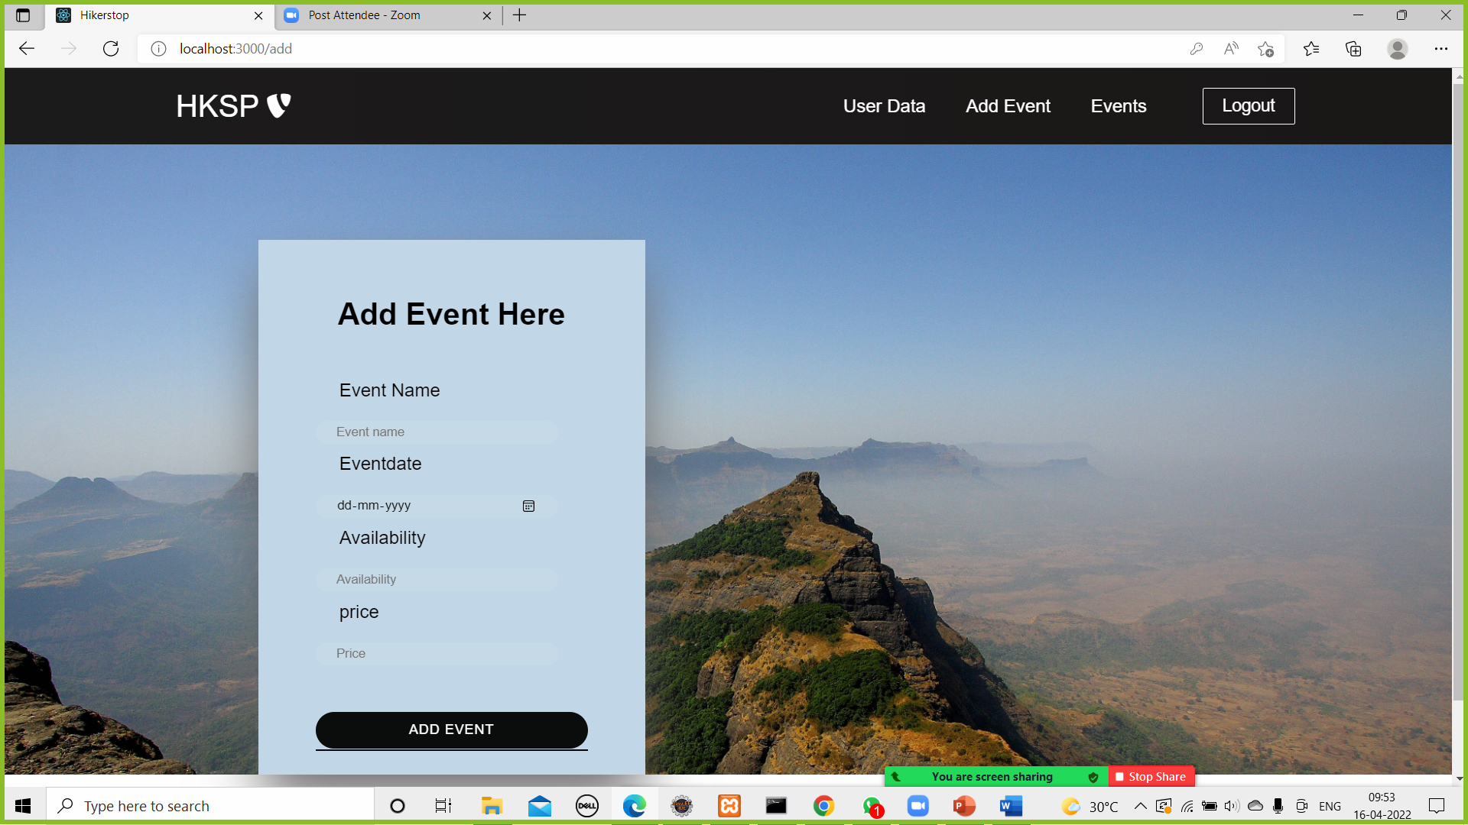

Slide 11
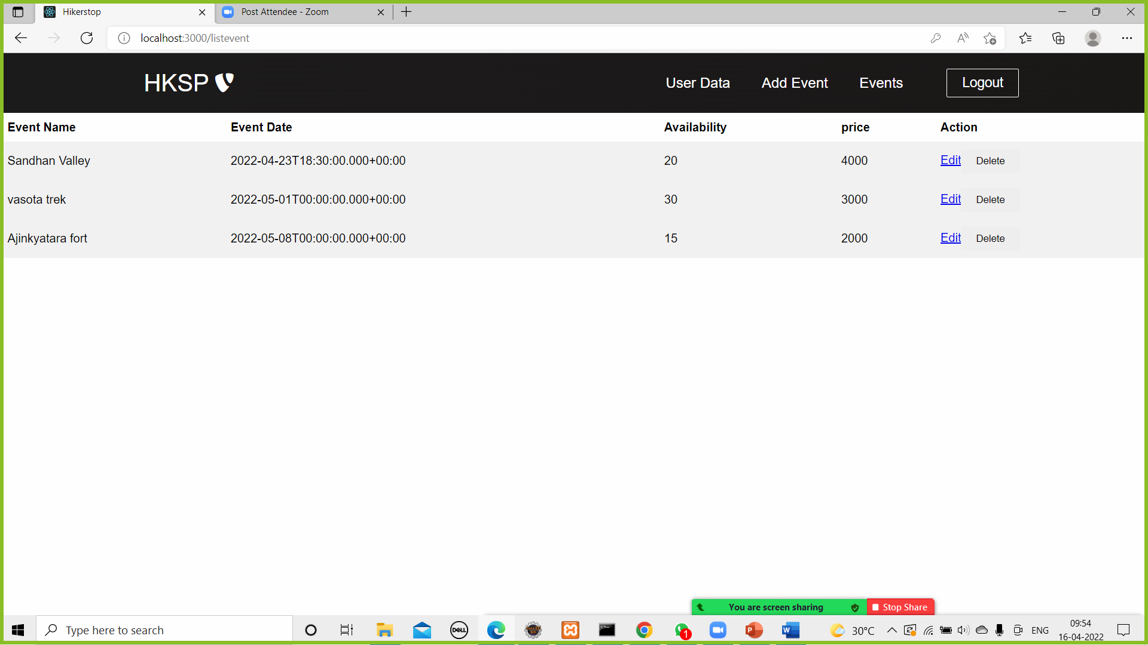

Slide 12
Future Scope
This Project can be further extended to Guides role where different Guides add their own and also add extra related information regarding to site
Travelling for foreigners, Trekkers, their dream lifes events can be managed by hikerstop.

Slide 13
Conclusion
Trekking event management system puts forth the actual working of a trekking in traditional way. Guides at online mode for customers and management is main key feature for project.
Customers and can online products and admin can manage orders at ease through this project using this website anywhere and anytime for their own comfort.

Slide 14


